Slide 1
Lecture No. 43 Nanomaterials
At the end of this session, student will be able to:
Explain the terminologies in nanoscience
Discuss the orientation of graphene and carbon nanotube
Application of graphene-polymer composites and carbon nanotubes

Slide 2
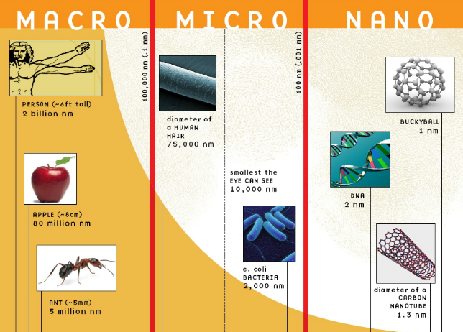
Nanomaterials

Slide 3


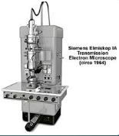
History
"There's Plenty of Room at the Bottom" was a lecture given by physicist Richard Feynman at an American Physical Society meeting
1980s, development enhanced due to advances in electron microscopy

Slide 4
Terminology
Nanoscience : study of phenomena and manipulation of materials at atomic, molecular, and macromolecular scales, where properties differ significantly from those at larger scales
Nanotechnology : production and application of structures,
devices, and systems for controlling shape and size at nanometer scale
1 nm = 10⁻⁹ of a metre (0.000 000 001 m, pretty small!)

Slide 5
Classification of the nanomaterials
Depends on the number of dimensions which lie within the nanometer range
Systems confined in 3 dimensions
Ex: Nanoparticles; Nanograins; Nanoshells; Nanocapsules; Nanorings; Fullerenes; colloidal particles; activated carbon; nanoporous silicon; quasi crystals
Systems confined in 2 dimensions
Ex: Nanorods; Nanofilaments; Nanotubes; quantum wires; nano
wires
Systems confined in 1 dimension
Ex: Discs; platelets; ultrathin films; super lattices; quantum wells

Slide 6
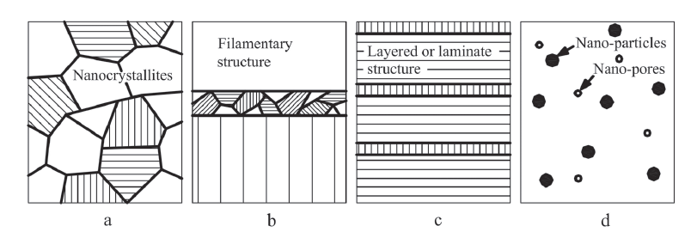
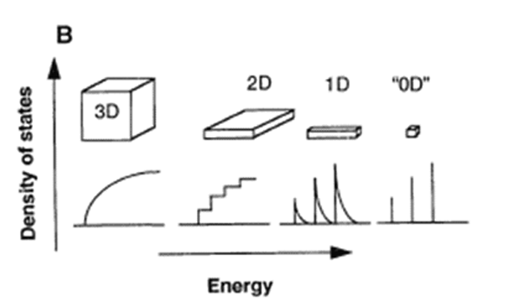
Classification of the nanomaterial's
Schematic classification of nano – materials: (a) three – dimensional structures; (b) two – dimensional; (c) one – dimensional; and (d) zero – dimensional structures
Figure: Different types of nanomaterials based ;DOS in the 1D solid decreases as the reciprocal of the square root of energy; In zero dimensions the energy states are sharp levels corresponding to the eigen states of the system

Slide 7
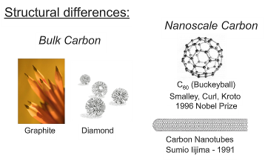
Properties of nanomaterials
Properties depends on size, composition and structure
• Nano size increases the surface area
• Change in surface energy (higher)
• Change in the electronic properties
• Change in optical band gap
• Change in electrical conductivity
• Higher and specific catalytic activity
• Change thermal and mechanical stabilities
• Different melting and phase transition temperatures
• Change in catalytic and chemical reactivities

Slide 8
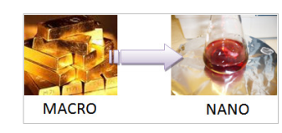
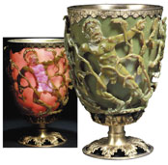
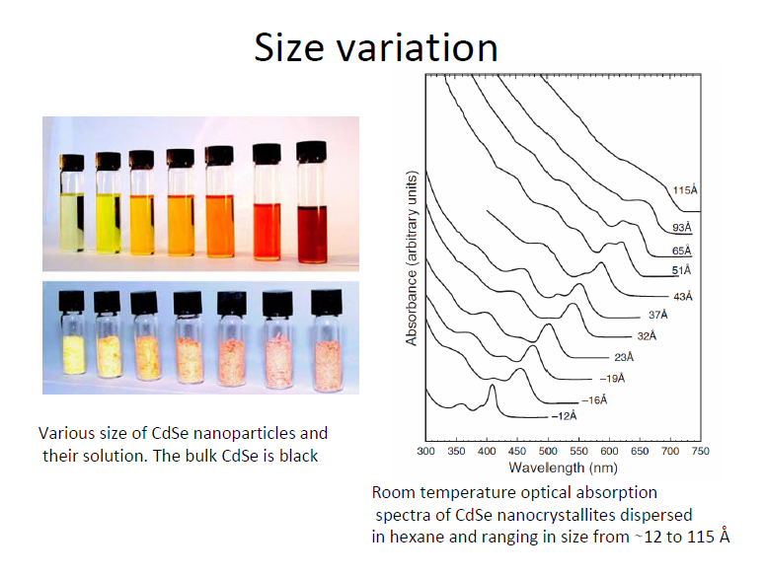
Size effect
Properties of materials are size dependent (matter at nanoscale no longer follows Newtonian physics but rather quantum mechanics)
Fig 3:Lycurgus cup: It appears green in reflected light, but appears red when light is shone from inside, and is transmitted through the glass
Fig 2: A colloid of gold nanoparticles is no longer ‘golden’ but ruby red in color

Slide 9
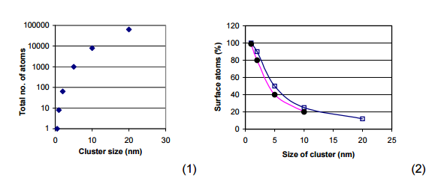
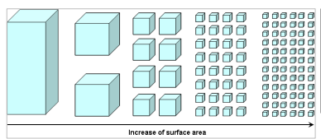
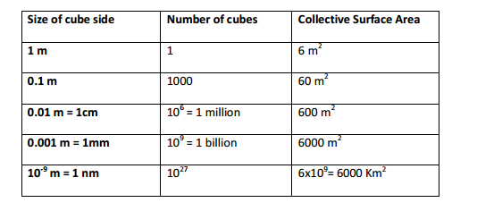
Increase in surface area

Slide 10
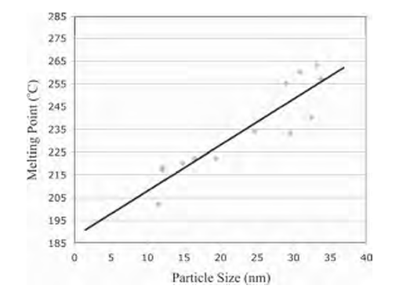
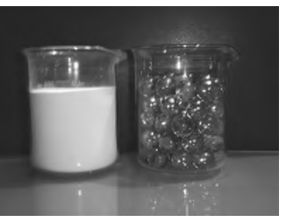
Melting point and surface area
Fig:Comparison of the surface area/volume
ratio of macroscopic particles (marbles) and nanoscopic aluminum oxide particles
Fig: Decrease in the melting point of gold nanoparticles with decreasing diameter.

Slide 11
Magnetic properties of nano materials
Large surface area to volume ratio results in a substantial proportion of atoms having different magnetic coupling with neighboring atoms leading to differing magnetic properties
Eg: Bulk gold and platinum are non magnetic but at the nano size they act as magnetic particles. Au nanoparticles become ferromagnetic when they are capped with the appropriate molecules such as thiol

Slide 12
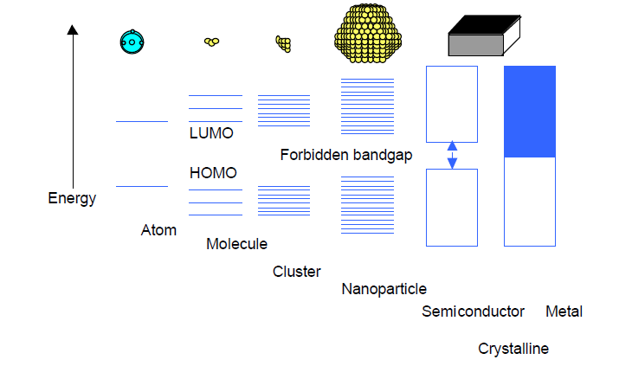
Electronic and optical properties of nanomaterials
Figure: Size quantization effect. Electronic state transition from bulk metal/semiconductor to small cluster
Band gap also increases when the particle size is decreased and the energy bands gradually convert into discrete molecular electronic levels
Ex: Metal particles consisting of 50 to 100 atoms with a
diameter between 1 and 2 nm start to loose their metallic
behaviour and tend to become semiconductors

Slide 13
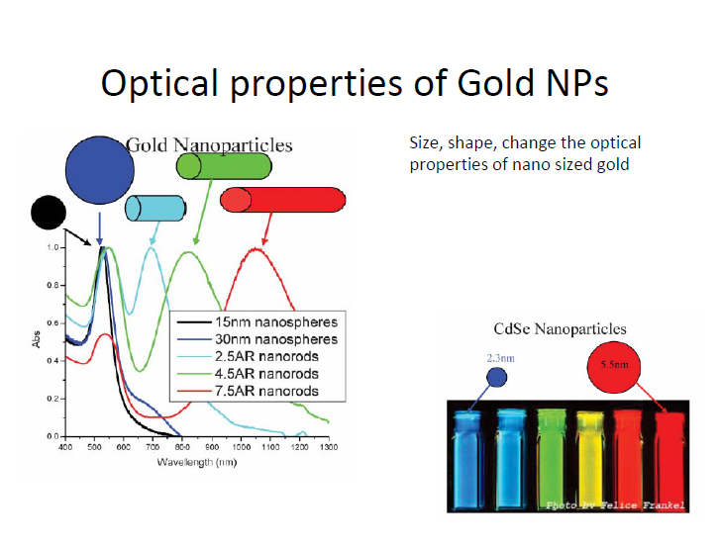
Optical properties of nanomaterials
Semiconductors and many metals show large changes in optical properties such as color, as a function of particle size
Colloidal suspensions of gold nano particles have a deep red color which becomes progressively more yellow as the particle size increases

Slide 14
Chemistry of nanomaterials
Naomaterials is formed of at least a cluster of atoms, often a cluster of the molecules and various types of bindings are also important in nanoscience
Intra-molecular bonding: bonding that involve changes in the chemical structure of molecules (ionic, covalent, metallic )
Intermolecular bonding : bonds that don’t involve in the chemical structure of the molecules (ion-ion, ion-dipole, Vander Waals interaction, hydrogen, hydrophobic, repulsive )

Slide 15
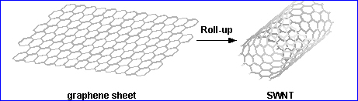
Carbon nanotubes
Fabricated through bottom-up approach
Cylindrical shells formed conceptually by rolling graphene (graphite like) sheets into closed tubular nanostructures with diameters matching that of C60 (0.5 nm) but lengths up to micrometers
Carbon nanotubes self-assemble into two distinct classes:
Single-Walled NanoTube SWNTs
MultiWalled carbon NanoTubes (MWNTs)

Slide 16
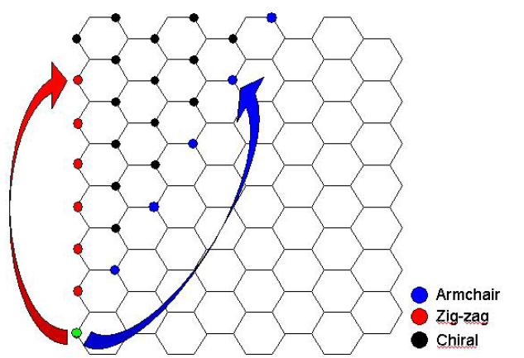
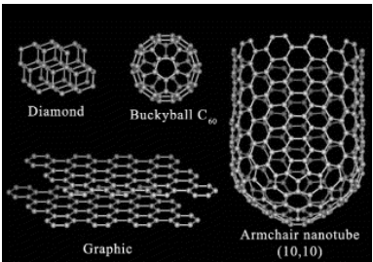
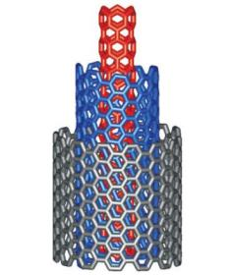
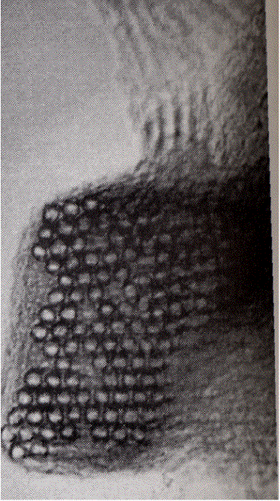
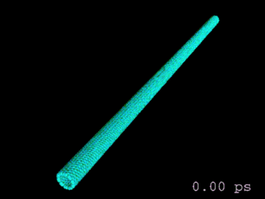
Nanotubes
Mechanically very strong (their Young’s modulus is over 1 terapascal), flexible (about their axis), and can conduct electricity (the helicity of the graphene sheet determines whether the CNT is a semiconductor or metallic)
SWNT
MWNT
SWNT bundle

Slide 17
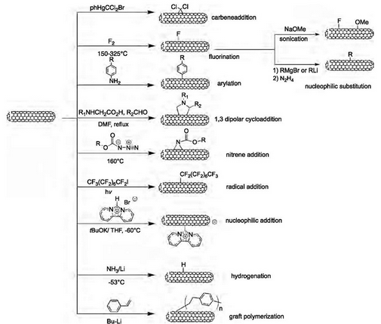
Schematic of the various methods to perform sidewall functionalization of SWNTs

Slide 18
Nanotubes Uses
Biological: drug delivery, trap dangerous substances, immobilization of enzymes, DNA transfection
Paints: improving strength & conductivity
Actuators: changing electrical energy into mechanical energy e.g. robotics
Electronics: semiconductors, diodes
Chemical industry: catalysts

Slide 19
Summary
Nanoscience : study of phenomena and manipulation of materials at atomic, molecular, and macromolecular scales, where properties differ significantly from those at larger scales
Classification of the nanomaterial's depends on the orientation of nanomaterials in zero, one, two structures
Carbon nanotubes self-assemble into two distinct classes:
Single-Walled NanoTube SWNTs
MultiWalled carbon NanoTubes (MWNTs)

Slide 20
https://www.youtube.com/watch?v=ebO38bbq0_4&list=PLbMVogVj5nJTdeiLvuGSB_AE8hloTAHWJ

